Slide 1


Spotify
Trends
BY SUNA TABAG
Presented by

Slide 2
Hypothosis
My starting hypothesis is that there will be a positive correlation between the number of playlists a song is in and its place on the Spotify chart. This is based on the idea that a song being added demonstrates an enjoyment of a song above just streaming it and therefore if that enjoyment is demonstrated more times the song should place higher in the Spotify chart.

Slide 3
Hypothosis
NULL HYPOTHESIS
ALTERNATIVE HYPOTHESIS
For the dataset Spotify-2023, there will be no difference in the Spotify chart placement of songs in several playlists compared to the Spotify chart placement of songs in few playlists.
For the dataset Spotify-2023, there will be a difference in the Spotify chart placement of songs in several playlists compared to the Spotify chart placement of songs in few playlists.

Slide 4


ARTIST_COUNT
RELEASED_YEAR
IN_SPOTIFY_PLAYLISTS
IN_SPOTIFY_CHARTS
STREAMS
BPM
DANCEABILITY_%
VALENCE_%
ENERGY_%
LIVENESS_%
MODE_MAJOR
MODE_MINOR
Column Names

Slide 5
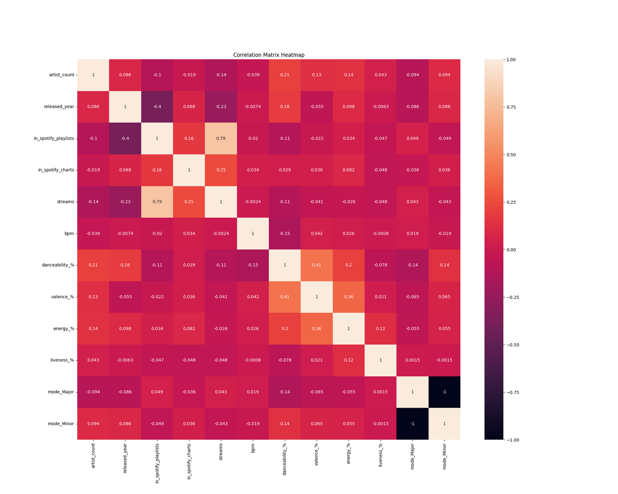
Heat
map

Slide 6
Linear Regression
COEFFICIENTS
0 ARTIST_COUNT -0.012628
1 RELEASED_YEAR 2.342627
2 IN_SPOTIFY_PLAYLISTS -0.769389
3 STREAMS 5.421305
4 BPM 0.170456
5 DANCEABILITY_% 0.738581
6 VALENCE_% 0.924362
7 ENERGY_% 0.435390
8 LIVENESS_% -0.443887
9 MODE_MAJOR -0.005553
10 MODE_MINOR 0.005553
Split the data into testing sets using in_spotify_charts and preform linear regression. Print the coefficients to show the relationship between the independant and dependant variables.
in_spotify_playlists has a slight negative correlation with in_spotify_charts

Slide 7
Elastic Net
COEFFICIENTS
0 ARTIST_COUNT -0.000000E+00
1 RELEASED_YEAR 2.008044E-01
2 IN_SPOTIFY
_PLAYLISTS -6.018758E-05
3 STREAMS 1.013415E-08
4 BPM 2.294040E-02
5 DANCEABILITY_% 1.729652E-02
6 VALENCE_% 1.736638E-02
7 ENERGY_% 8.285700E-02
8 LIVENESS_% -5.392012E-02
9 MODE_MAJOR -0.000000E+00
10 MODE_MINOR 0.000000E+00
Use Lasso from Sklearn to find and print Elastic Net coefficients. Elastic Net is useful to figure out how all the variables contribute to the overall prediction and accounts for multicollinearity.
in_spotify_playlists has a negative correlation with in_spotify_charts

Slide 8
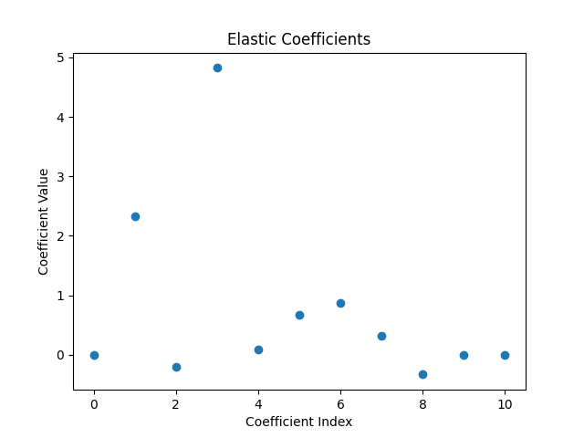

Slide 9
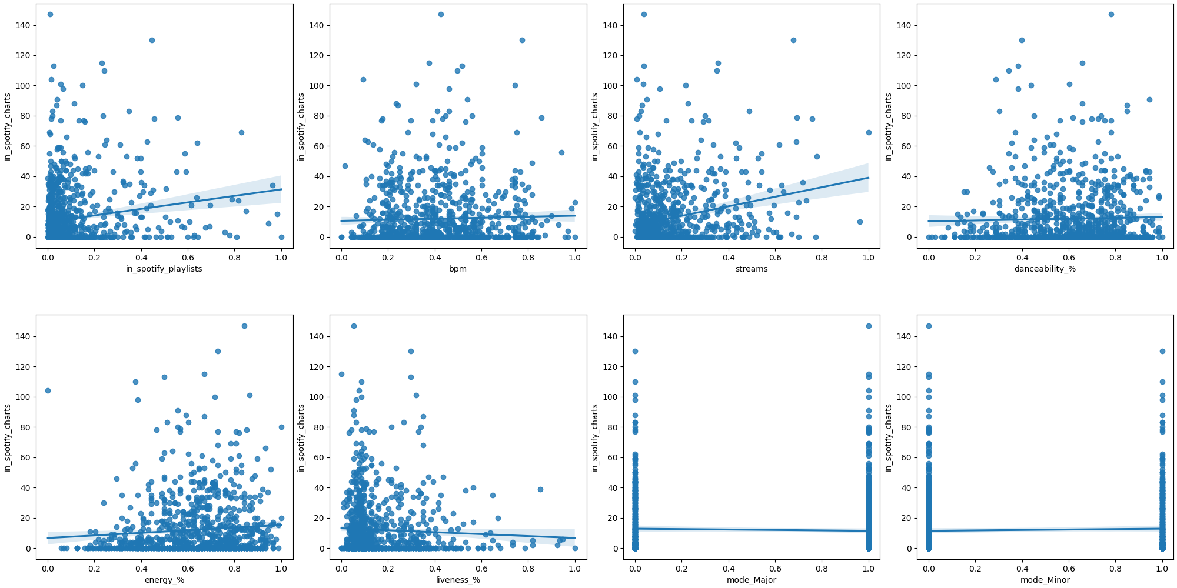


Slide 10
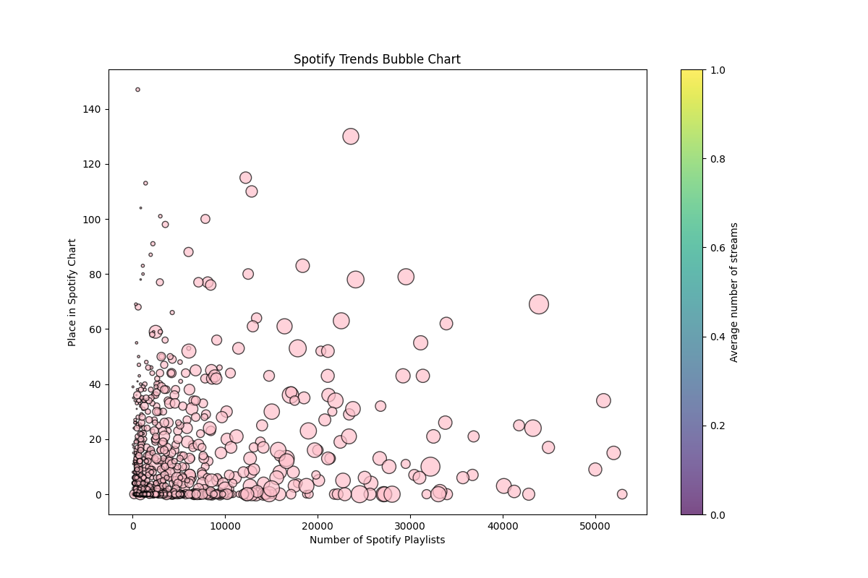
Bubble
Chart
Compares number of Spotify playlists to place in Spotify chart with the number of streams determine the bubble size. This shows that there is not a significant relationship between number of playlists and place in chart, but there seams to be a postive correlation between number of streams and number of playlists

Slide 11
Final Thoughts
There does not appear to be a positive correlation between the number of playlists a song is in and its place on the charts. There appears to be a slight negative correlation, but it is not very significant nor linear, as can be most clearly seen on the graphs.

Slide 12
Thank you!

